Slide 1


News-App Clone
A Comprehensive News Experience
Author: Raghav Kumar Prabhakar

Slide 2


Overview
Description of News-App: The News-App is an Android application built with Kotlin using Android Studio, designed to deliver the latest Indian news. Similar to Google News, the app provides a comprehensive news experience by fetching and displaying news articles from various sources.
Key Points - Built with Kotlin , Developed in Android Studio , User-friendly and categorized by topics for easy navigation

Slide 3
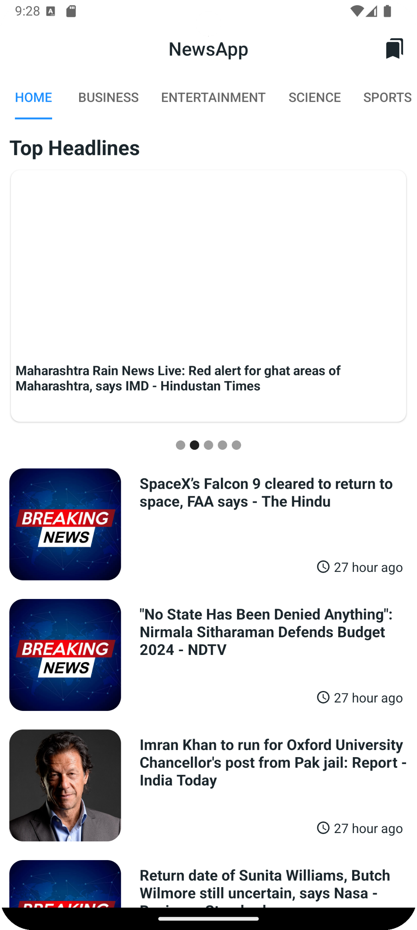

Features
Top Headlines: Get the most recent news updates from multiple sources.
Category Browsing: News is categorized into sections like Technology, Sports, Business, Entertainment, and more.
Search Functionality: Users can search for specific news articles using keywords.
User-friendly Interface: A clean and intuitive design for a seamless user experience.

Slide 4
Architecture & API Integration
API Integration: Fetches news from a third-party news API to provide the latest news updates. The API ensures real-time data fetching, making the news app current and relevant.
View Binding: Utilizes View Binding for efficient and safe interaction with UI components. This approach reduces the need for findViewById calls, preventing potential null pointer exceptions.
Retrofit and Gson:
Retrofit: A type-safe HTTP client for Android and Java, used for handling network requests. It simplifies the process of connecting to web services and managing API calls.
Gson: A library for converting Java objects to JSON and vice versa. It is used in conjunction with Retrofit to parse JSON responses from the API into Java/Kotlin objects.

Slide 5

Installation
Cloning the Repository:
Sh -git clone https://github.com/Raghavkumarprabhakar/Android-Projects.git
cd Android-Projects/NewsApp
Opening in Android Studio:
Launch Android Studio.
Open the NewsApp project directory.
Building the Project:
Android Studio will download the necessary dependencies and build the project.
Running the App:
Connect an Android device or use an emulator.
Click on the 'Run' button in Android Studio.
This Photo by Unknown Author is licensed under CC BY

Slide 6
Access Credentials & Contact
API Key Configuration: Ensure your gradle.properties file includes the following line with your API key:
NEWS_API_KEY=your_api_key_here
Contact Information:
Author: Raghav Kumar Prabhakar
Email - raghavkumarprabhakar50@gmail.com

